Slide 1
Java Programming – Unit II Packages – Chapter 9

Slide 2

What is Package?
Packages are containers for classes.
Used to keep the class name space compartmentalized
Avoids: A unique name had to be used for each class to avoid name collisions
The package is both a naming and a visibility control mechanism
Define classes inside a package that are not accessible by code outside that package
Define class members that are exposed only to other members of the same package

Slide 3
Defining a Package
Include a package command as the first statement in a Java source file
If you omit the package statement, the class names are put into the default package, which has no name
Default packages are not suitable for real time apps
package pkg_name;

Slide 4
Defining a Package…
The .class file should be stored in the directory where the .java file is present.
Directory names are case-sensitive
More than one file can include the same package statement
Java uses file system directories to store packages.

Slide 5
Package Hierarchy
NewPackage
package NewPackage;
package NewPackage.PackageA;
PackageA
PackageB
PackageC
Package123
package NewPackage.PackageA.Package123;

Slide 6
Finding Packages and CLASSPATH
How does the Java run-time system know where to look for packages that you create?
3 ways
Java run-time system uses the current working directory as its starting point
Can specify a directory path or paths by setting the CLASSPATH environmental variable
Can use the -classpath option with java and javac to specify the path to your classes

Slide 7
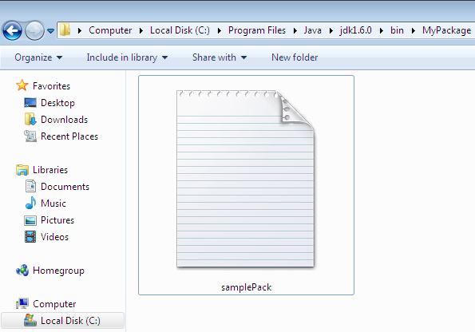

package MyPackage;
class samplePack
{
public static void main(String arg[])
{
System.out.println("Hello World");
}
}

Slide 8
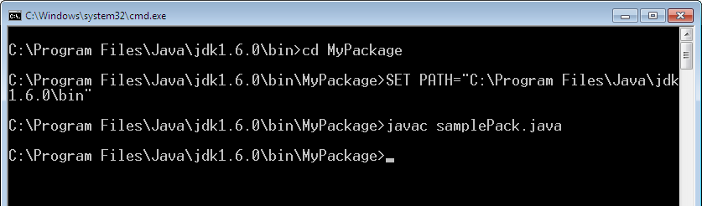
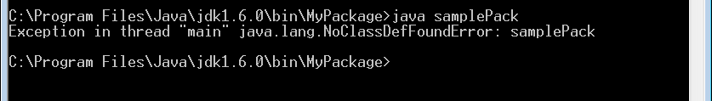

Slide 9
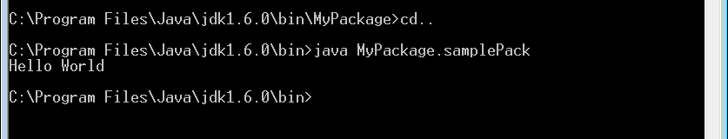

Slide 10
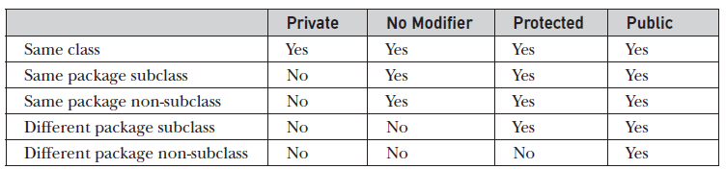
Access Protection
4 categories of visibility for class members:
Subclasses in the same package
Non-subclasses in the same package
Subclasses in different packages
Classes that are neither in the same package nor subclasses

Slide 11
package p1;
public class base
{
int i=0;
int j=0;
int k=0;
int p=0;
public void disp()
{
i=10;
j=20;
k=30;
p=40;
System.out.println("i="+i+"\nj="+j+"\nk="+k+"\np="+p);
}
}

Slide 12
package p1;
public class derived extends base
{
public void disp_der()
{
System.out.println("i="+i+"\nj="+j+"\nk="+k+"\np="+p);
}
}
package p1;
class packdemo
{
public static void main(String args[])
{
base b=new base();
derived d=new derived();
b.disp();
d.disp_der();
} }

Slide 13
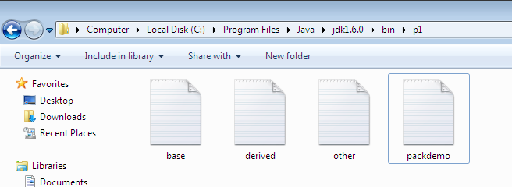
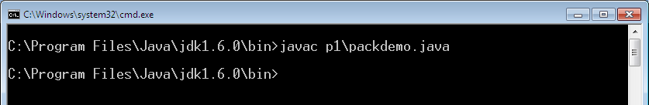
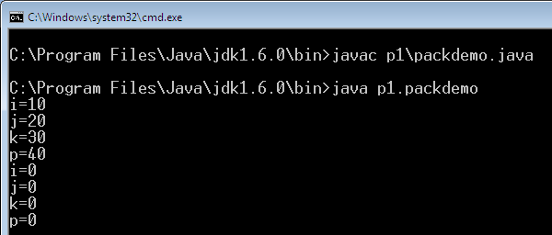
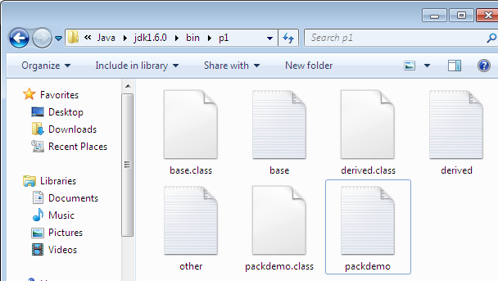

Slide 14
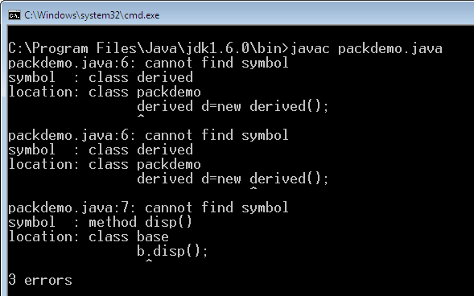
Importing Packages
Move “packdemo.java” to bin directory
Remove “package p1” statement from “packdemo.java”
Run “packdemo.java

Slide 15
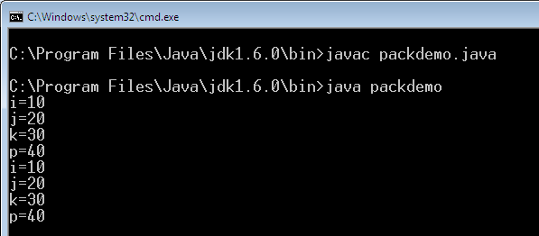
Import Statement
import p1.*;
class packdemo
{
public static void main(String args[])
{
derived d=new derived();
d.disp_der();
} }

Slide 16
Interfaces
What is Interface?
Defining and Implementing Interface
Accessing through Interface References
Partial Implementations
Nested Interfaces
Interface Variables and Extends
Example: Stack Program

Slide 17
Interfaces
Using interface, you can specify what a class must do, but not how it does it
Only method declaration, without implementation
Similar to class, but
No instance variables (final)
Methods without body
Any number of classes can access (implement) this interface

Slide 18
Interfaces …
A class can implement any number of interfaces.
Hence achieving multiple inheritance
Drawback of multiple inheritance?
Class A
Class B
void get()
{
SOP(“Should be printed”);
}
void get()
{
SOP(“Should not be printed”);
}
Class C
C cc = new C ();
cc.get();

Slide 19
Defining an Interface
interface <interface_name>
{
return-type method1(args);
return-type method2(args);
datatype variable1=value;
datatype variable1=value;
}
These variables are by default “static” and “final”

Slide 20
Implementing Interfaces
Include the implements clause in a class definition
Create the methods required by the interface
class <c-name> implements <interface_name>
{
public return-type method1(args) { …….. }
public return-type method2(args) { …….. }
}

Slide 21
interface inter
{
void display();
int i=10;
}
class sam1 implements inter
{
void display()
{
System.out.println("Hello; inside sam1. Value of i="+i);
}
}
class sam2 implements inter
{
void display()
{
System.out.println("A new method. Inside sam2. Value of i="+i);
}
}

Slide 22
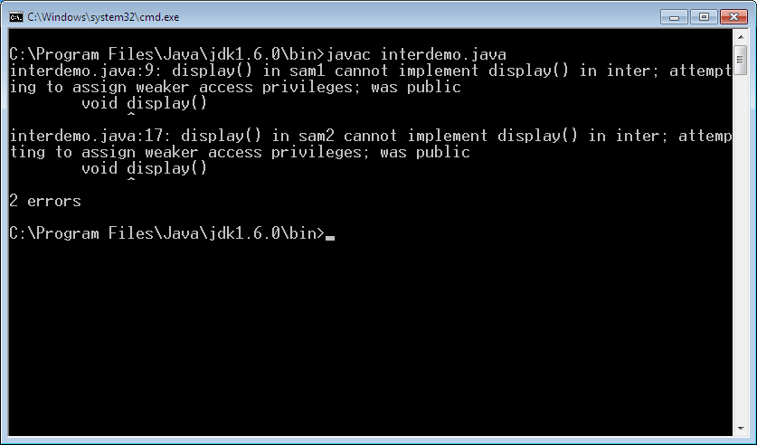
class interdemo
{
public static void main(String args[])
{
sam1 s1=new sam1();
sam2 s2=new sam2();
s1.display();
s2.display();
}
}

Slide 23
interface inter
{
void display();
int i=10;
}
class sam1 implements inter
{
void display()
{
System.out.println("Hello; inside sam1. Value of i="+i);
}
}
class sam2 implements inter
{
void display()
{
System.out.println("A new method. Inside sam2. Value of i="+i);
}
}
public
public

Slide 24
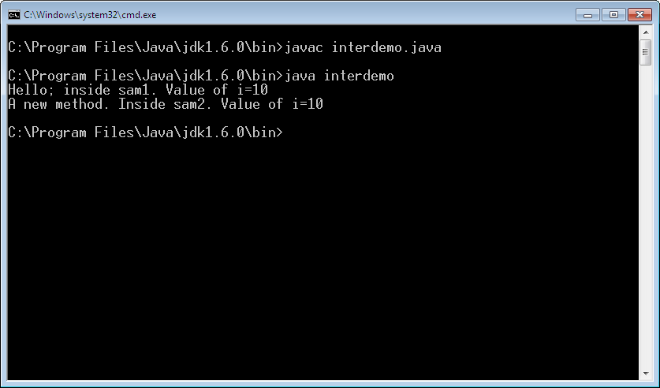
class interdemo
{
public static void main(String args[])
{
sam1 s1=new sam1();
sam2 s2=new sam2();
s1.display();
s2.display();
}
}

Slide 25
Accessing Implementations Through Interface References
class interdemo
{
public static void main(String args[])
{
inter inn=new sam1();
inn.display();
inn=new sam2();
inn.display();
}
}
Variable “inn” is of type “inter” interface.
But initialized/ assigned with the address of Class sam1 and sam2

Slide 26
Accessing Implementations Through Interface References
class interdemo
{
public static void main(String args[])
{
inter inn=new sam1();
inn.display();
sam2 ss=new sam2();
inn=ss;
inn.display();
} }
Variable “inn” is initialized with the address of Class sam1
Then it is assigned (overwritten) with the address of Class sam2

Slide 27
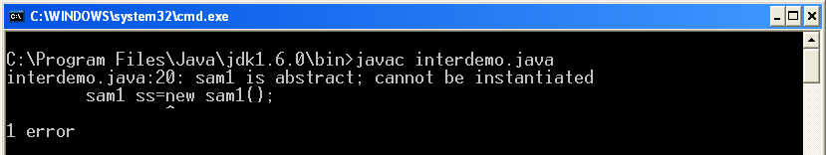
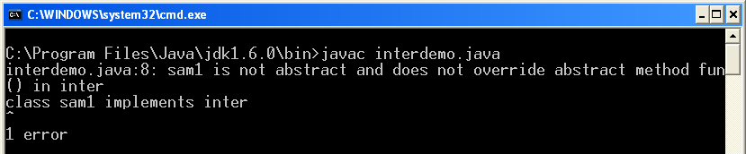
Partial Implementations
interface inter
{
void display();
void fun();
}
class sam1 implements inter
{
public void display()
{
System.out.println("Hello; inside sam1”);
}
}
class interdemo
{
public static void main(String args[])
{
sam1 ss=new sam1();
ss.display();
}
}
abstract

Slide 28
Nested Interfaces
An interface can be declared a member of a class or another interface
2 ways of declarations:
interface <outer_interface>
{
Methods…
interface <inner_interface>
{
Methods…
}
}
class <class_name>
{
Methods…
interface <interface_name>
{
Methods…
}
}

Slide 29
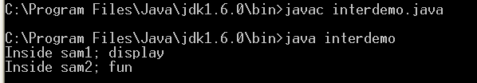
interface outer
{
void display();
interface inner
{
void fun();
}
}
class sam1 implements outer
{
public void display()
{
System.out.println("Inside sam1; display");
}
}
class sam2 implements outer.inner
{
public void fun()
{
System.out.println("Inside sam2; fun");
}
}
class interdemo
{
public static void main(String args[])
{
sam1 s1=new sam1();
s1.display();
sam2 s2=new sam2();
s2.fun();
}
}

Slide 30
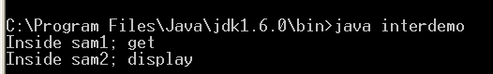
class sam1
{
interface inner
{
void display();
}
void get()
{
System.out.println("Inside sam1; get");
}
}
class sam2 implements sam1.inner
{
public void display()
{
System.out.println("Inside sam2; display");
}
}
class interdemo
{
public static void main(String args[])
{
sam1 s1=new sam1();
s1.get();
sam2 s2=new sam2();
s2.display();
}
}

Slide 31
Variables in Interfaces
Variables used in interfaces are by default final
Used to import shared constants into multiple classes

Slide 32
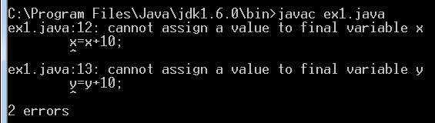
Variables in Interfaces
interface vari
{
int x=10;
int y=20;
void get();
}
class A implements vari
{
public void get()
{
x=x+10;
y=y+10;
System.out.println("X="+x+"Y="+y);
}
}
class ex1
{
public static void main(String args[])
{
A aa=new A();
aa.get();
}
}

Slide 33
Interfaces Can Be Extended
interface interA
{
void meth1();
}
interface interB extends interA
{
void meth2();
}
class sample implements interB
{
public void meth1()
{ …}
public void meth2()
{…}
}
class sample implements interA
{
public void meth1()
{ …}
}

Slide 34
Example – Stack Implementation
Implement “STACK” using interface, class and array.
Create an interface with 2 method declarations:
void push(int item);
int pop();
Class 1: FixedStack
Stack size=5
Items to be pushed and popped: 10,20,30,40,50
Class2:DynamicStack
Stack size & items to be pushed and popped – entered by user

Slide 35
Thank You

